Slide 1

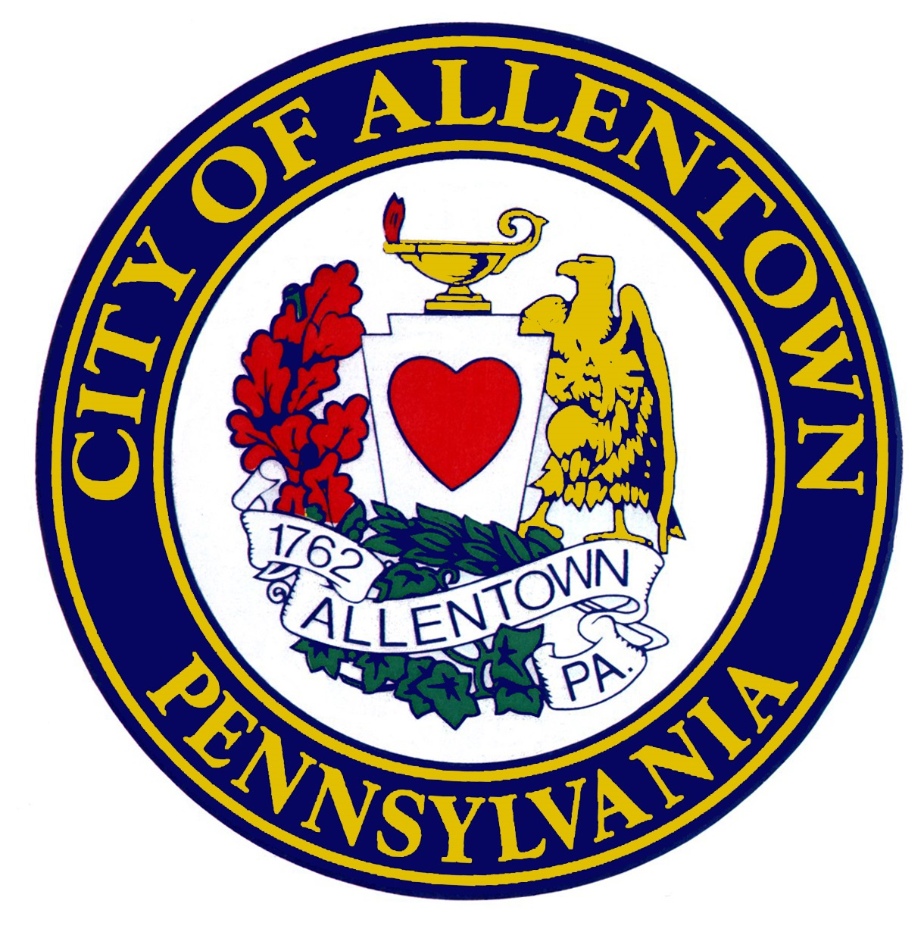

City of Allentown Five Year Consolidated Plan 2025-2029 Planning Kick-Off and Overview
For the use of Community Development Block Grant (CDBG) Funds from the U.S. Department of Housing and Urban Development (HUD)

Slide 2
Today’s Agenda
Welcome
Purpose of Today’s Meeting
What is a Consolidated Plan?
An Overview of the federally-required Consolidated Planning process and Timeline
Public Participation, stakeholders, and how to Participate and give input
Questions
Conclusion

Slide 3
Purpose
Kick-off Meeting to start the Consolidated Planning process – focusing on community and public engagement.
What is required by the U.S. Department of Housing and Urban Development (HUD) in order to access Allentown’s Community Development Block Grant (CDBG) and HOME Investment Partnership Program (HOME) entitlement funds.
Outline the work, project goals, and timing.
Provide an overview of the community and public engagement work and how to get the word out regarding public input opportunities.
Answer initial questions regarding the process and funding.

Slide 4
What’s a Consolidated Plan?
The Consolidated Plan is:
Created every 5 years.
Is driven by federal planning, data, template requirements.
Is a time limited process.
Is used by the City to help set strategic goals with regard to its CDBG and HOME funds that meet federal eligibility limitations and requirements.
Provides opportunity for community-wide participation and input.
Components that together make up the suite of the Consolidated Plan Process include:
The Citizen Participation Plan.
The Analysis of Impediments to Fair Housing.
The 5 Year Consolidated Strategic Plan
The 1 Year Annual Action Plan
The Year End Accomplishment Report to HUD known as the CAPER (Consolidated Annual Performance and Evaluation Report)
Any subsequent Substantial Plan Amendments.
These all run on a rolling 5 year and 1 year plan basis.

Slide 5
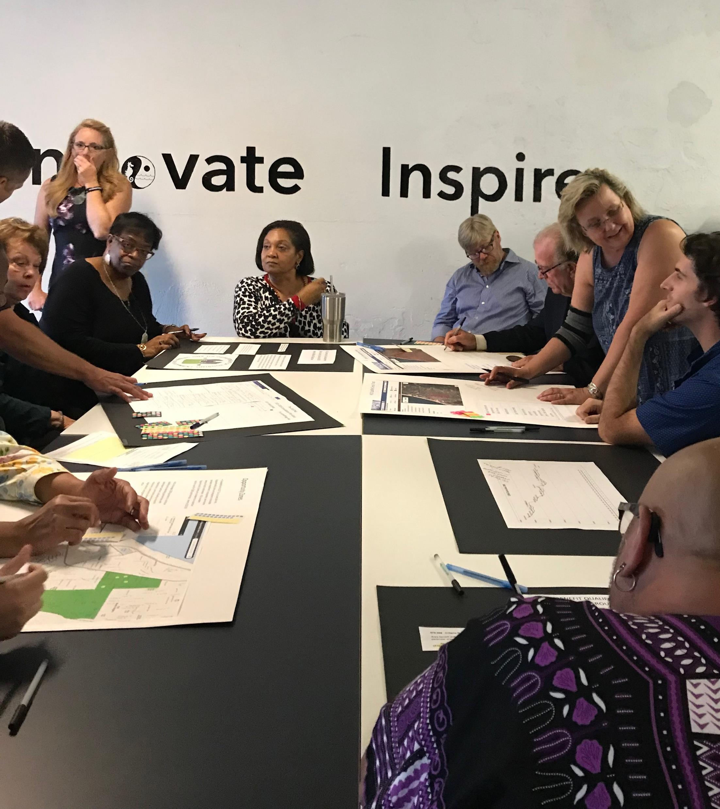
What’s a Consolidated Plan, cont.
The Consolidated Strategic Plan gathers and analyzes elements and sets strategic priorities and ranks needs as required by HUD:
Data collection about housing needs, population demographics, housing, income, and population trends.
Public and stakeholder outreach to gather additional information about needs and trends.
Results of prior CDBG and HOME investment and continued needs.
Ranks needs by High, Medium, Low for purposes of analyzing award funding.

Slide 6






An Overview of the Consolidated Planning Process and Timeline
Finalize Plan, final changes, public hearing for adoption. Plan to HUD for review and approval
Data and community input analysis, mapping
Setting draft priorities and draft ranking, setting draft resources
Draft Analysis of Impediments and Consolidated Plan development, public comment
Determine Needs – Data gathering
Public engagement, surveys, interviews

Slide 7
Overview of Process and Timeline Continued
The Consolidated 5 Year Strategic and 1 Year Action Plan must conform to HUD’s template and be uploaded into the federal Information system. Jurisdictions must complete all required sections to have a Plan that HUD will approve.
The Consolidated Plan is a time and labor-intensive project that takes place in a very compressed amount of time.
As part of the process, there will be public participation forums, a community survey, stakeholder interviews, public hearings and required public comment periods.

Slide 8
Lots of Needs, Finite Resources:
So, how much are we talking about annually?
First, it’s variable and depends on a formula based on community need and population. Second, it’s subject to Congressional approval – which means the formula gets applied AFTER Congress decides the total allocation. For Allentown, this means, about $2,300,000 per year, plus potential Program Income that its CDBG programs may earn.

Slide 9



Resources, cont.
To be an eligible project, it must meet both a national objective AND be an eligible activity. If the project can meet only 1 of these criteria, it is NOT eligible. The National Objectives are serving a Low to Moderate Income Area (LMA) with activities that benefit the low to moderate persons in the service area. Low to Moderate Income Persons (LMI) activities, such as residential rehabilitation or public services that provide assistance to qualified low to moderate income persons.
Slum Blight. This designation does NOT meet the eligibility requirements for low to moderate income persons and is generally used in emergency situations when there is not other funding. In addition, eligible activities are severely restricted. Use of this objective directly affects the 70% low to moderate income expenditure requirements.
Of the annual CDBG allocation, up to 20% can be used for planning and/or program administration. Only 15% of the total can be used to fund public services. At least 70% of all funds must be spent on qualified Low to Moderate (up to 80% of median income) persons and families.

Slide 10

Public Participation, Stakeholders, Surveys
In accordance with the City’s approved Citizen Participation Plan and HUD requirements, the City is engaged in community outreach through a variety of formats and forums. Here is an overview of the engagement process:
Updated the City’s CDBG webpage with current and up to date information.
Created flyers and social media toolkits to assist with getting the word out to the community.
Set up a Community Survey as well as this kick-off meeting, and two (2) Community Forums. The Survey and Forums are being advertised via the City’s website, social media accounts, as well as email outreach to interested parties.
Have identified Community Stakeholders and set up stakeholder interviews to get additional input from those working directly with affected populations.

Slide 11
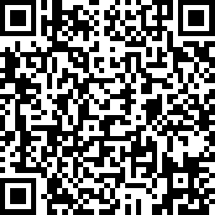
The Community Survey
Please take our 2025-2029 Community Survey by scanning the QR code below:

Slide 12
Next Steps
After completing the citizen engagement, forums, and survey –
Analyze data and community input
Draft Analysis of Impediments and Consolidated Plan
To Advisory Committee for comment
Publish the documents for Public Comment
To Council for consideration of Adoption at public hearing
To HUD for review and approval

Slide 13
Questions?

Slide 14

Contact Information
Teri Dakuginow – Grants Manager Teresa.Dakuginow@allentownpa.gov
Austin Knudsen – austin.knudsen@mbakerintl.com

Slide 15


